Slide 1

Introduction to AI CT017-3-1-IAI Ver 1.0
Introduction to Expert Systems

Slide 2
Topic & Structure of The Lesson
Categories of Expert Systems
Components of Expert Systems
Expert System shell

Slide 3
Learning Outcomes
At the end of this topic, You should be able to
Introduction to Expert Systems
Categories of Expert Systems
Components of Expert System
Expert System Shell

Slide 4
Key Terms You Must Be Able To Use
If you have mastered this topic, you should be able to use the following terms correctly in your assignments and exams:
Expert System
Domain expert
Knowledge Engineer
Domain

Slide 5
What is Expert System
Expert systems were the first major economically successful product resulting from the study of Artificial Intelligence
An expert system is a computer program which can do the job of a human expert
An expert system can be defined as "a computer program which can draw reasoned conclusions from a body of knowledge in a restricted domain".

Slide 6
Functions of an expert system
An expert system represents the knowledge of one or more domain experts.
A simple expert system may represent the knowledge of a single expert, but most commercial expert systems represent the knowledge on many experts.
The purpose of an expert system is to provide advice to a user through a process of consultation.
The expert system can provide this consultation through a series of questions to the user

Slide 7
continued
A good expert system will also be able to explain to the user:
why certain questions are being asked
how it reached its conclusion

Slide 8
Applications of expert systems
Expert systems have been developed for a wide range of domains. These include systems giving medical, legal or financial advice, but the range of domains is increasing
Notes:
Medical Expert Systems - MYCIN
Geological Exploration
Computer Configuration
Chemical Analysis
Legal Advice – SHYSHER - australia
Finance
Manufacturing
Car fault diagnosis – expertise2go
Bank loan decisions
Plant recognition

Slide 9
Categories of Expert Systems
The output provided by expert systems can be used for:
Advice
Classification
Diagnosis
Planning.

Slide 10
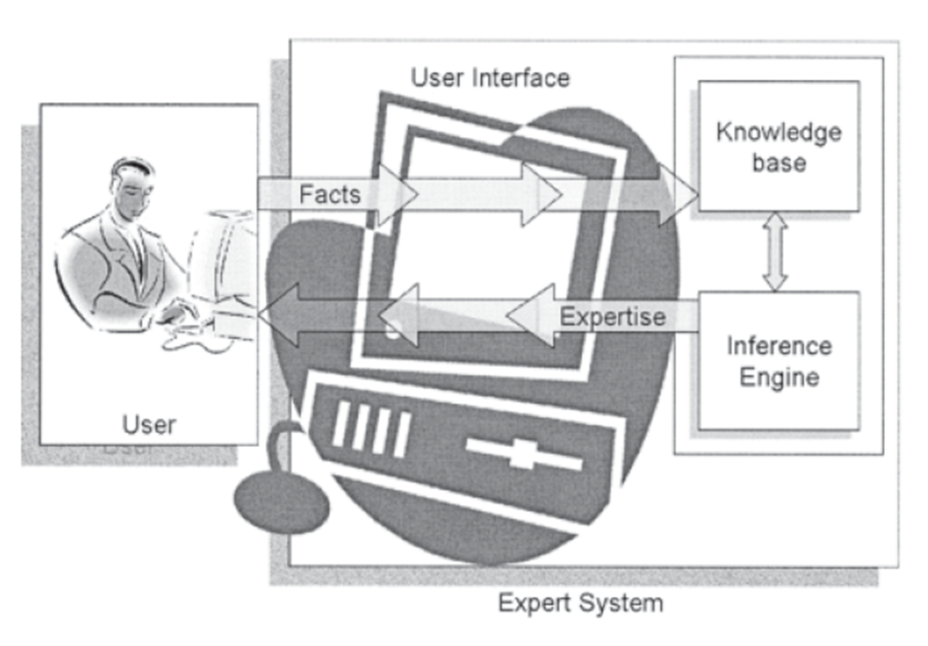
Components of Expert Systems

Slide 11
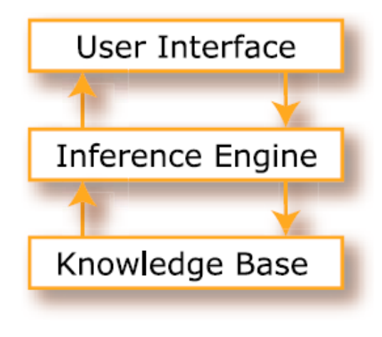
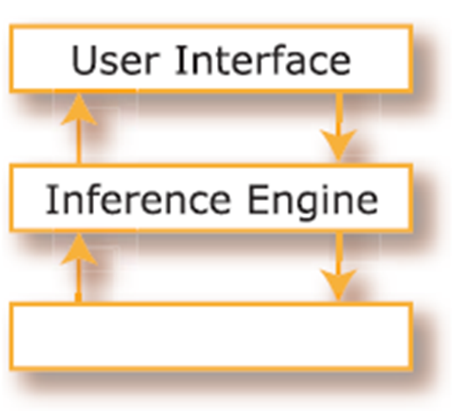
Expert System Shell
Anatomy of an expert system

Slide 12
Question
State the purpose of the expert system
So why bother developing systems to replace human experts?
Write down the advantages and disadvantages
Describe three functions of an expert system.
Where does the knowledge in an expert system come from?
An expert system entitled ‘Parliament: How it Works’ is being created. Identify two appropriate domain experts for this expert system.
Identify the three components of an expert system.
What two forms of output are generated from an expert system?

Slide 13
Summary of Main Teaching Points
Expert systems use a different approach; they collect the small fragments of human know-how into a knowledge-base which is used to reason through a problem, using the knowledge that is appropriate.
A different problem, within the domain of the knowledge-base, can be solved using the same program without reprogramming. The ability of these systems to explain the reasoning process through back-traces and to handle levels of confidence and uncertainty provides an additional feature that conventional programming doesn’t handle

Slide 14
Question and Answer Session
Q & A

Slide 15
Case study : Amazon
Amazon Global Logistics Technology
https://www.youtube.com/watch?v=1PHwq1-f62k
Amazon is using AI in almost everything it does
https://www.youtube.com/watch?v=2DtyjC0UxTw The Grand Theory of Amazon
https://www.youtube.com/watch?v=UyohSu-Ft_U

Slide 16
What we will cover next
Expert Systems
Knowledge
Information
Data

